Slide 1

操作系统
钟竞辉
办公室：B3-515
电子邮箱：jinghuizhong@scut.edu.cn

Slide 2

主观题
1分
What are the three major components of security?
（1）Data confidentiality；（2）____; (3)____。
正常使用主观题需2.0以上版本雨课堂
作答

Slide 3
What are the three major components of security?
（1）Data confidentiality
（2）Data integrity
(3) System availability

Slide 4
Malicious code （Malware）
Definition of traditional computer viruses: a set of computer instructions or programs that can destroy computer functions or data and self-replicating, which are programmed as or inserted into programs.
The official definition of computer viruses doesn’t cover the new malicious codes.
Definition of malicious codes: Software or codes aimed at destroying hardware or software, stealing user information or disturbing users without authorization.

Slide 5
Examples of malicious code
Traditional computer viruses
Trojan Horses
Worms
Rogue software（流氓软件）
Backdoor
Mobile malicious code
…

Slide 6
History of Viruses
Core War: 1960s, assembly language, programs attacked each other, program A ate program B
Fred Cohen wrote the first computer virus on Unix on November 3, 1983.
1980s, Dos era, about 5000 kinds of viruses
In 1990, the AF/91 virus paralyzed some Windows hosts in the Iraqi Air Force’s defense system.
Worm era: about 2000, based on the Internet
In 2010, the Iranian nuclear facility system was infected by the worm "Super Factory"; the purpose was to destroy specific targets rather than to release information.
Trojan Horse era: invisibility, current mainstream
Mobile malicious code: development of mobile phones
New trend: IoT, industrial control field, ransomware（勒索软件）

Slide 7
Virus
Virus: a special program that can reproduce itself by attaching its code to another program. Once executed, the virus can do whatever damages onto the victim’s computer.
A program which can reproduce itself
Attaching to another program
Do damages
Features of virus
Fast to spread
Difficult to detect
Difficult to delete

Slide 8
Worms
Worm: A kind of malwares that exploit system vulnerabilities for self-reproduction. Without attaching to other programs, it can be executed independently.
Worms can cause network congestion.
A worm consist of two programs:
The bootstrap
The worm proper
A worm hides its existence firstly, and then it attempts to spread its bootstrap to other machines connected to the host computer.

Slide 9


Slide 10
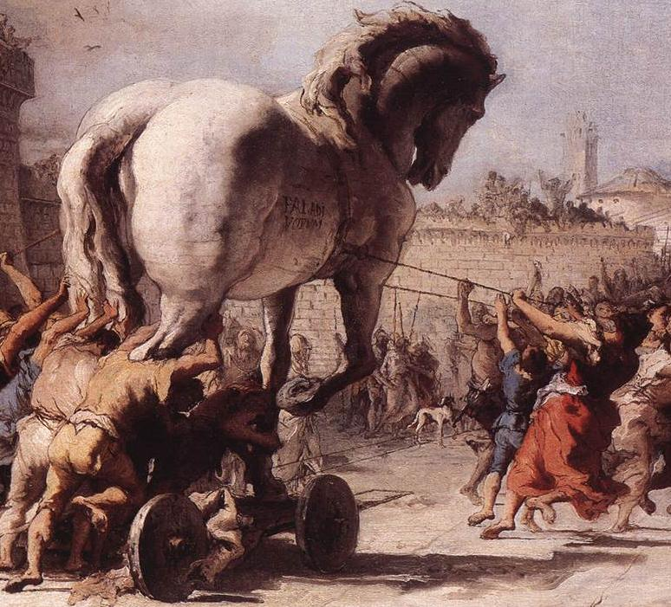
Trojan Horses
Trojan Horse is a tale from the Trojan War: the Greeks using a subterfuge to enter the independent city of Troy.
After a fruitless of 10-year siege, the Greeks constructed a huge wooden horse, and hid a select force of men inside.
The Greeks pretended to sail away, and the Trojans pulled the horse into their city as a victory trophy.
That night, the Greek force crept out of the horse and opened the gates for the rest of the Greek army.
Finally, the Greeks entered and destroyed the city of Troy, ending the war.

Slide 11
Trojan Horses
Control a victim’s computer via a specific program called the Trojan horse program.
No self-reproduction; No voluntary infection
Break into a victim’s computer by hidden in software or a Web page that people voluntarily download.
The malware can steal the victim’s files, remotely control the victim’s computer once the downloaded Trojan horse program gets executed

Slide 12
Trojan Horses
Features:
Invisibility: the primary feature; no icon, not appear in the software manager, etc.
Autorunning
Fraudulence: deceptive names, commonly used icons
Automatic recovery
Open specific ports automatically

Slide 13

Malwares : Virus, Worm, and Trojan Horses

Slide 14
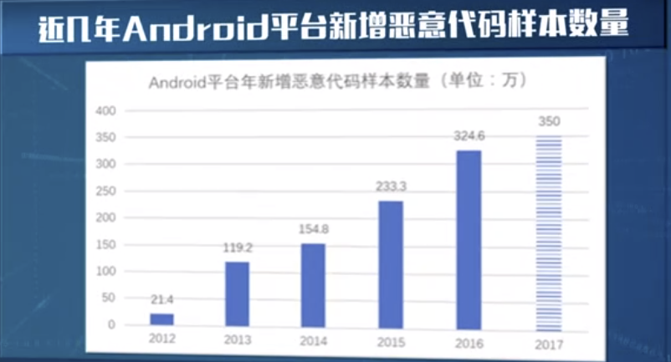
Mobile malicious code
New type viruses whose infected targets are mobile phones
-- uses mobile networks and computer networks as platforms
-- uses virus messages to attack mobile phones
-- result in anomaly.
Typical mobile OS
Android
IOS
Windows Phone
Symbian
Linux
BlackBerry
Webos-Palm

Slide 15
How to guard against mobile phone malicious codes
1. Check calling information and do not answer calls from abnormal numbers
2. Download files from the Internet carefully
3. Reject abnormal messages, especially messages with links
4. Turn off wireless and Bluetooth when unnecessary
5. Pay attention to safety information and take precautions

Slide 16
How to guard against mobile phone malicious codes
Improve security awareness, use protective tools and download files carefully)
Network traffic detection
Update software and install patch
Back up important files

Slide 17


Slide 18
How Viruses Work (I)
A virus is usually written in assembling languages and is inserted into a program, using a tool called a “dropper”
Once installed on the victim’s machine, the virus lies dormant until the infected program is executed.
Once started, it usually begins by infecting other programs on the machine and then executing its payload.

Slide 19
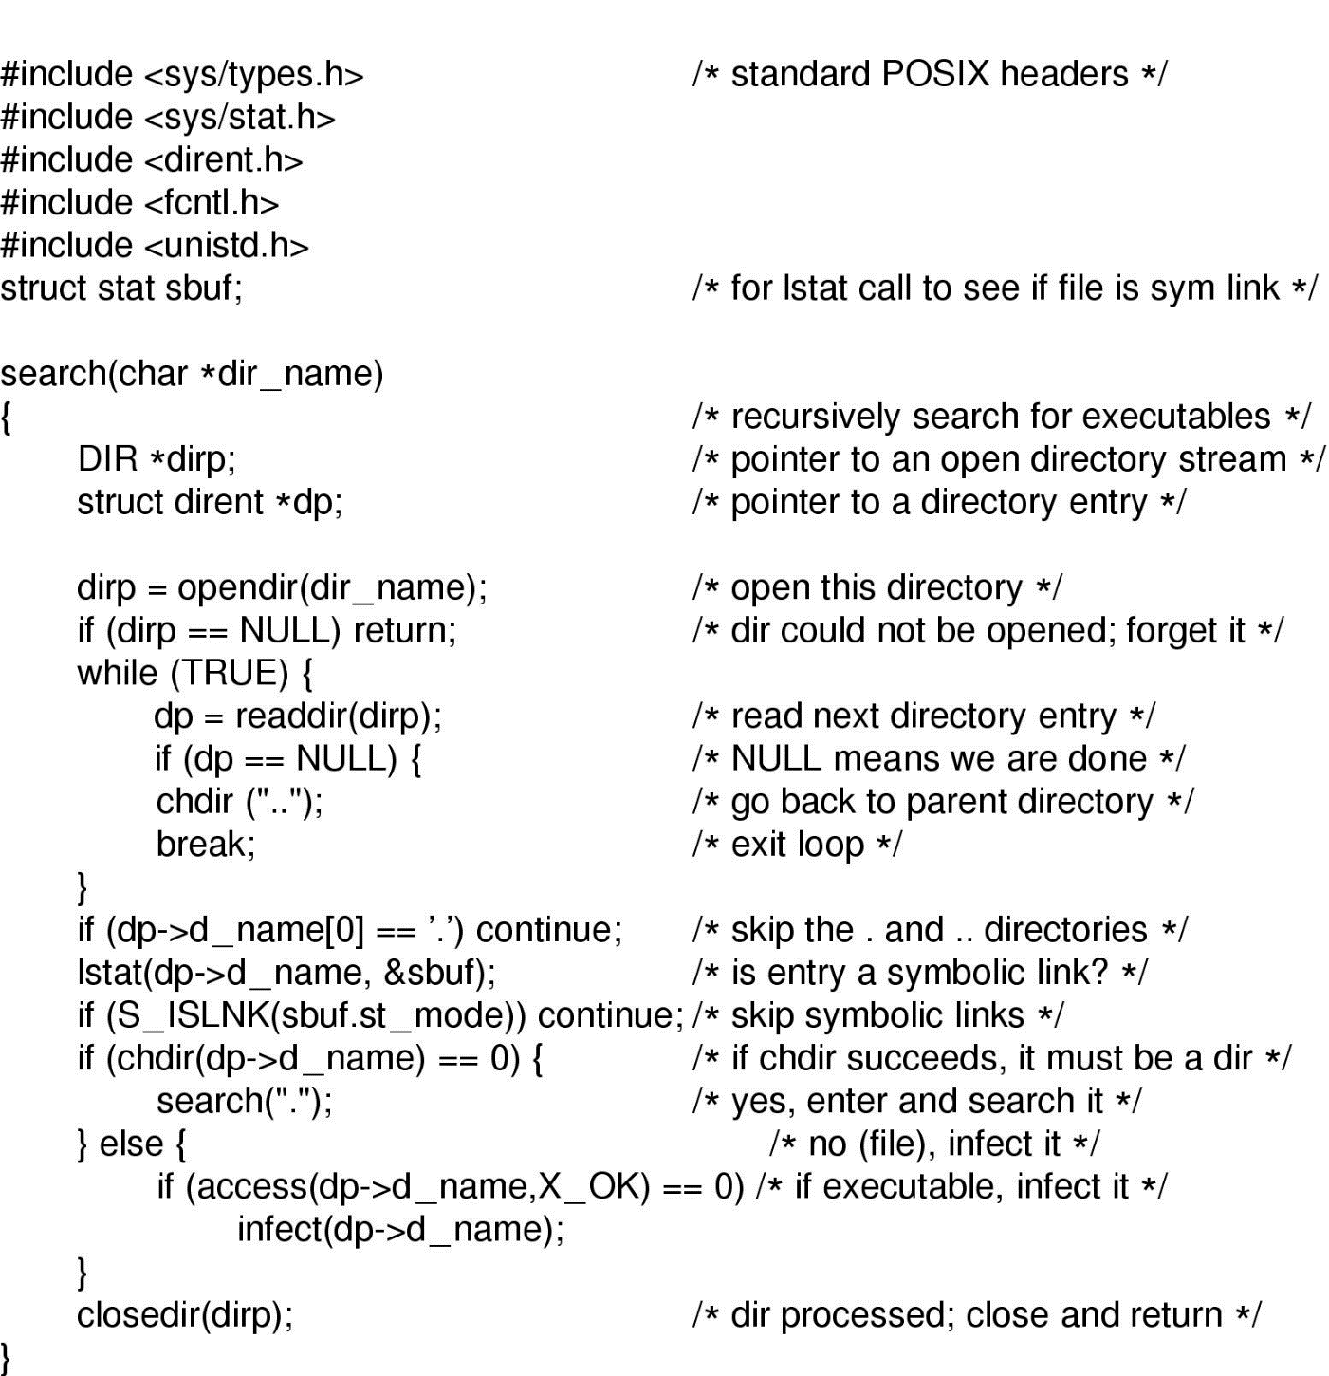
How Viruses Work(II)
An example of a virus recursively find executable files on a UNIX system and infect them.

Slide 20
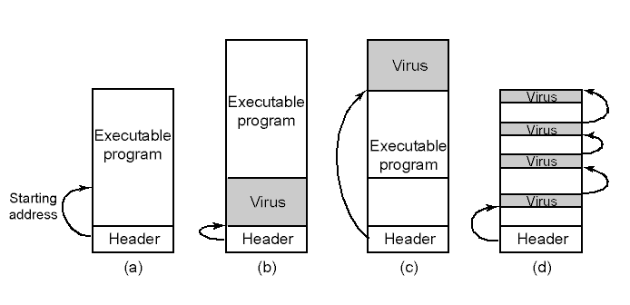
How viruses work (III)
An executable program
With a virus at the front
With a virus at the end
With a virus spread over free space within the program

Slide 21
How to spread the viruses
Put viruses in places which have frequent copy operation
After duplication
Infect the programs on the hard disk
May spread on the LAN
Play as the attachment of E-mails
Spread the virus using the list of E-mails

Slide 22
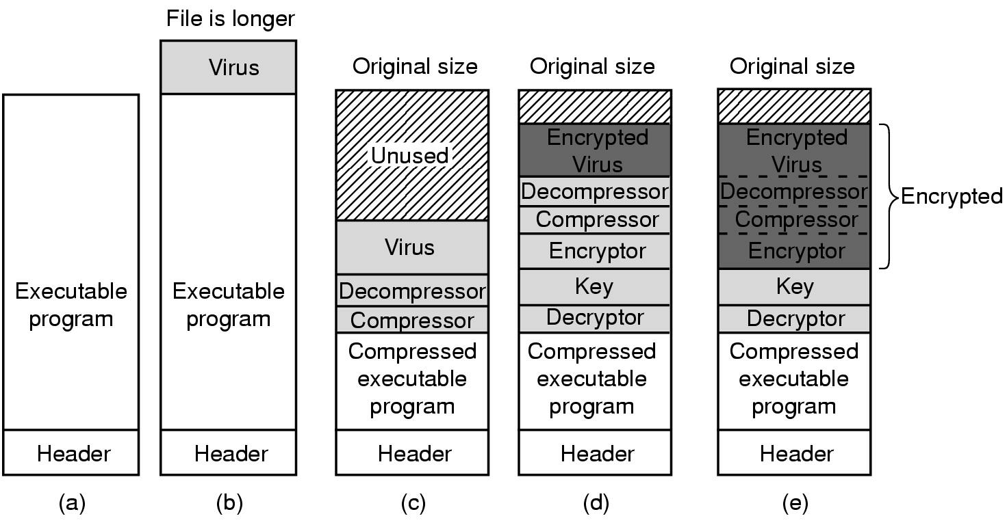
Antivirus and Anti-Antivirus Techniques
(a) A program
(b) An infected programs
(c) A compressed infected program
(d) An encrypted virus
(e) An compressed virus with encrypted compression code

Slide 23
Antivirus and Anti-Antivirus Techniques
Integrity Checkers
Behavioral Checkers
Virus Avoidance
An operating system that offers a high degree of security
Install only the software from a reliable manufacturer
Buy a good antivirus software package.
Do not click on attachments to e-mails
Make frequent backups of key files
Recover from the virus attack
Shut down the computer, restart it on the safe disk and run the antivirus software

Slide 24

Covert Channels
The encapsulated server can still leak to the collaborator via covert channels.
The client, server, and collaborator processes

Slide 25
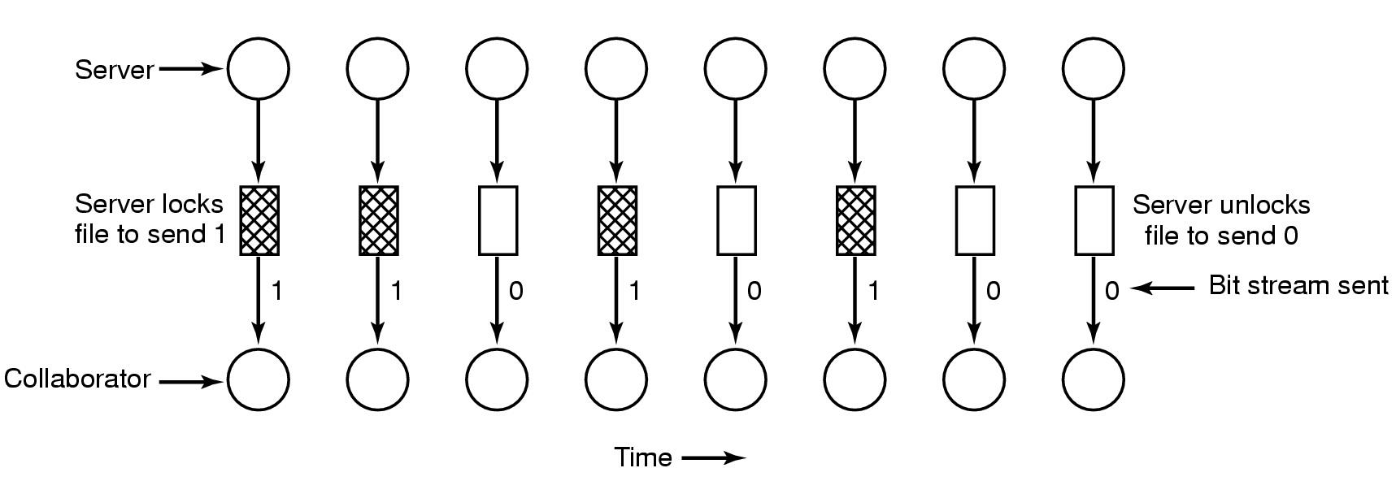
Covert Channels
A covert channel using file locking

Slide 26
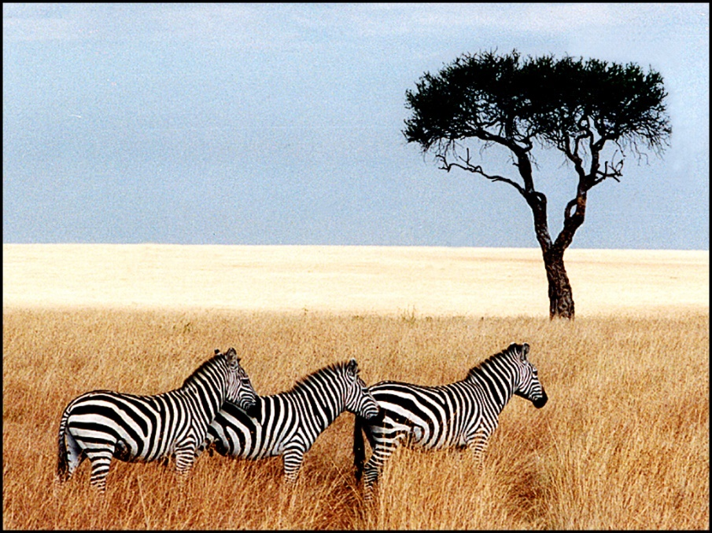
Covert Channels
Two “identical” pictures. The right one contains the complete, unabridged text of five of Shakespeare’s plays.
The encoding method uses the low-order bit of each RGB color value as a covert channel
Three zebras, a tree, and the complete text of five plays by Shakespeare.
Three zebras and a tree

Slide 27
单选题
1分
Which of the following statements is wrong ()
A
The symmetric encryption algorithm is fast to implement, so it is suitable for large quantities of data encryption
B
The security of symmetric encryption algorithm will depend on the secret of key, not the secret of algorithm
C
Asymmetric encryption algorithms require more keys than symmetric encryption algorithms
D
Asymmetric encryption algorithm is more suitable for digital signature than symmetric encryption algorithm
提交

Slide 28
主观题
1分
Consider a secret-key cipher that has a 26*26 matrix with the columns headed by ABC..Z and the rows also named ABC…Z? plaintext is encrypted two characters at a time. The first character is the column; the second is the row. The cell formed by the intersection of the row and column contains two ciphertext characters. What constraint must the matrix adhere to and how many secret-key matrices can meet the requirements?
正常使用主观题需2.0以上版本雨课堂
作答

Slide 29
Consider a secret-key cipher that has a 26*26 matrix with the columns headed by ABC..Z and the rows also named ABC…Z? plaintext is encrypted two characters at a time. The first character is the column; the second is the row. The cell formed by the intersection of the row and column contains two ciphertext characters. What constraint must the matrix adhere to and How many secret-key matrices can meet the requirements?
Answer:
(1) constraint: There are no two identical ciphertext characters in the secret-key matrix.
(2) （26 * 26）！

Slide 30
Case Studies: Unix/Linux

Slide 31
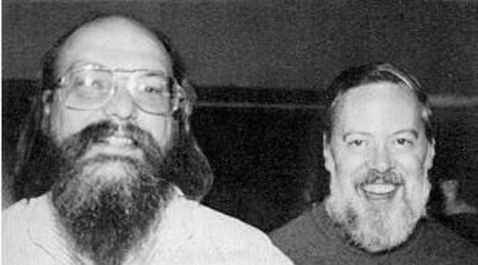
Unix/Linux History
UNICS (Uniplexed Information and Computing Service, 1st version of UNIX)，1969，assembly language
Keb Thompson（left）and Dennis M.Ritchie（right）

Slide 32
Unix/Linux History
PDP-11 UNIX (a popular computer, PDP-11),1973, K. Thompson & D. M. Ritchie
Portable UNIX (with a portable compiler written in C, Bell Lab, Steve Johnson), 1979.
Berkeley UNIX (1~4BSD)
University of California Berkeley, UCB (K. Thompson’s Once studied here), 1979-1983

Slide 33
Unix/Linux History
Standard UNIX
Portable Operating System Interface of UNIX, POSIX, IEEE, version 1003.1, produced in 1990 (modified in 1995)
Minix:
Microkernel design, C and assembler. Dutch Scientist A. Tanenbaum, for educational purpose, 1987
Linux:
Full-blown production system, a Finnish student, Linus Torvalds, 1991

Slide 34

The Development of Linux

Slide 35
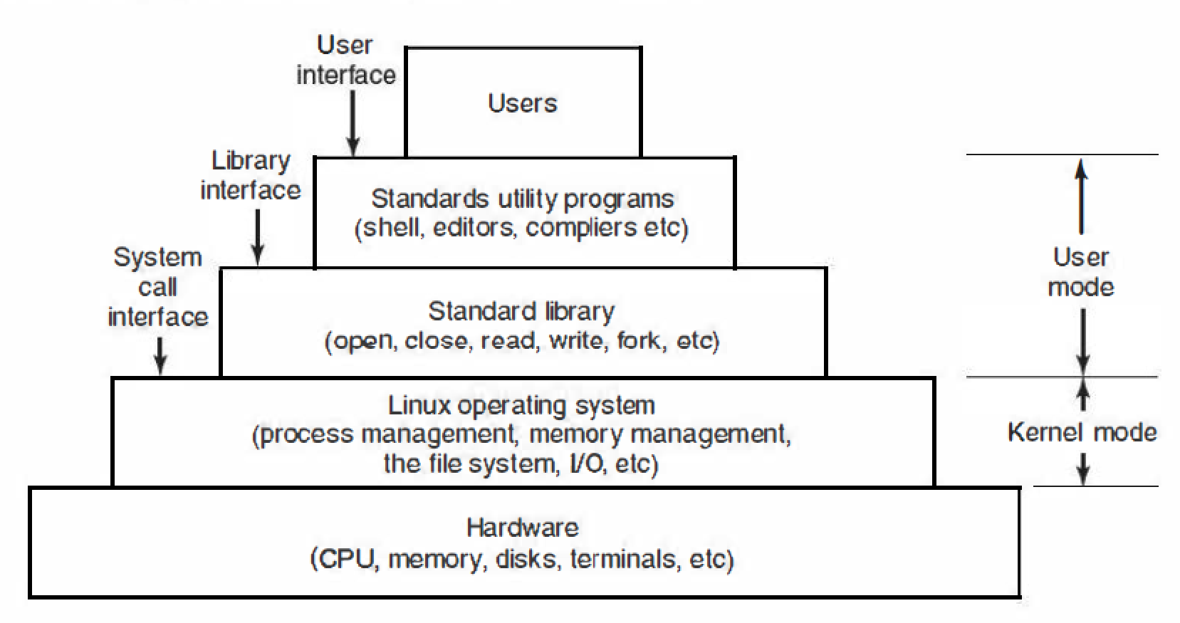
The Layers in a Linux System
The OS controls hardware and provides system calls for user programs；Linux also provides many utility programs required by POSIX.
The layers in a Linux system.

Slide 36
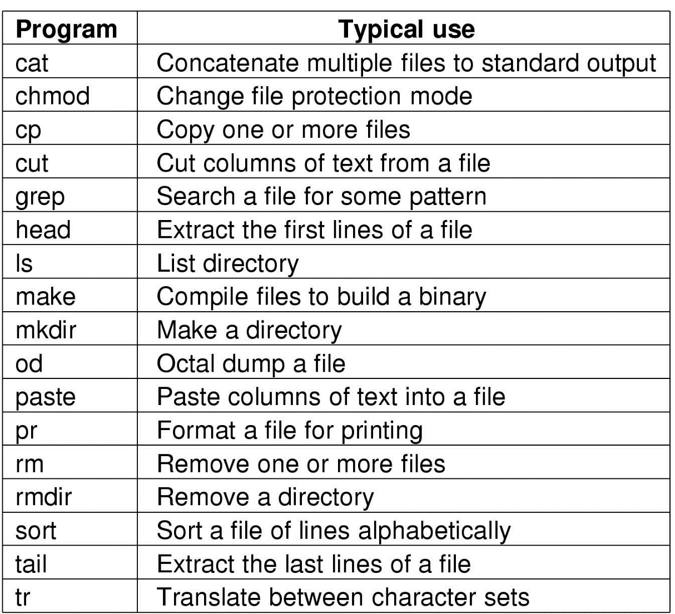
Linux Utility Programs
Example utility programs required by POSIX

Slide 37
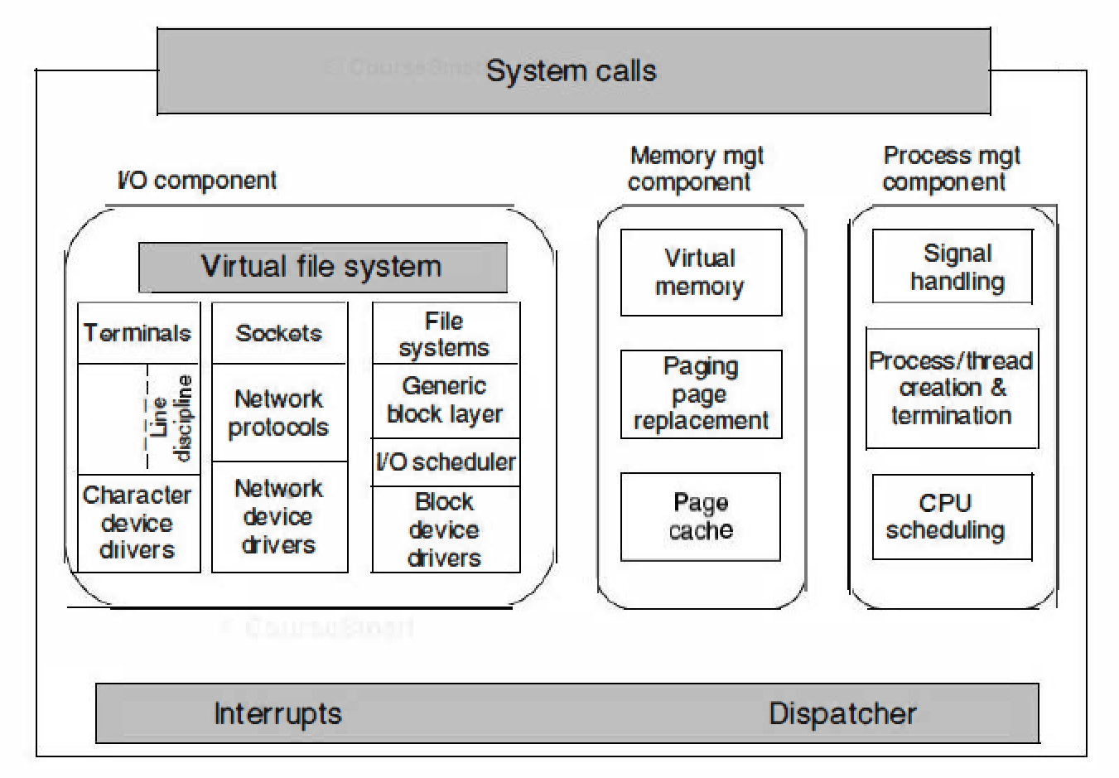
Linux Kernel
The kernel sits directly on the hardware and consists of : I/O devices Component; Memory Management Component, and Processes Management Component
Structure of the Linux kernel

Slide 38
Concepts Related to Linux Processes
Daemon: a kind of special processes running on the background;
Parent process: the forking process;
Child process: the new process created by the fork System call;
PID: Process Identifier, nonzero;
Process group: consists of its parent, further ancestors, siblings, children, and further descendants;
Signal: information, arguments, etc. that a process sends to another process.

Slide 39
主观题
1分
Please explain the meaning of Process Table and PCB.
正常使用主观题需2.0以上版本雨课堂
作答

Slide 40
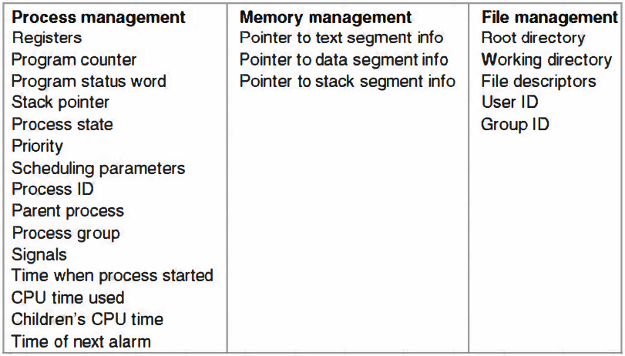
Process Implementation
Process table
A table maintained by the operating system to implement the process model. (One entry per process, which is called the process control block)
Example fields in a typical process control block (PCB)

Slide 41
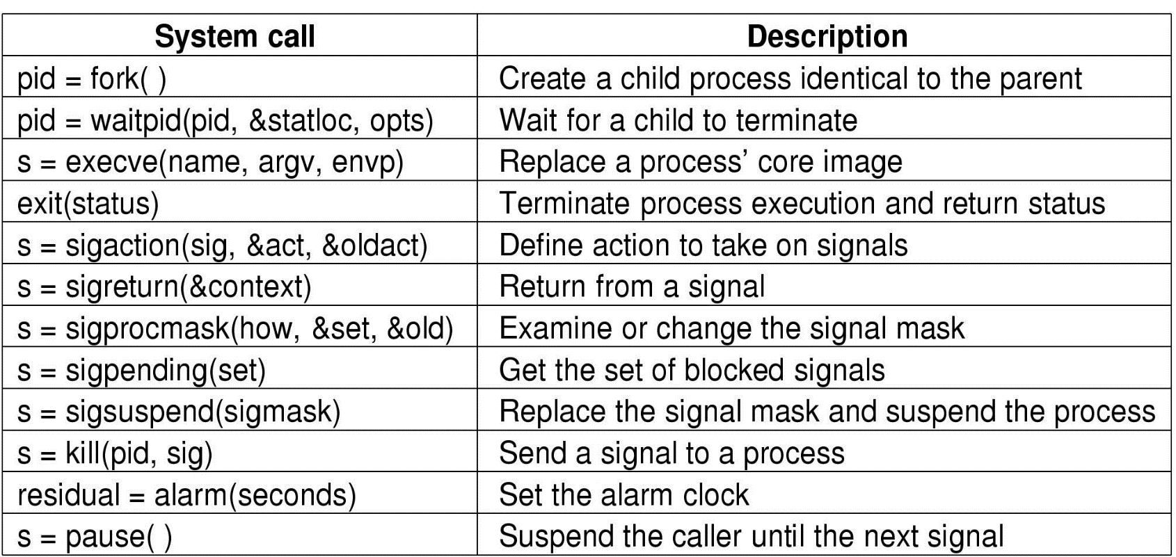
System Calls Related to Processes
s: error code; pid: process ID;
residual: the remaining time in the previous alarm

Slide 42
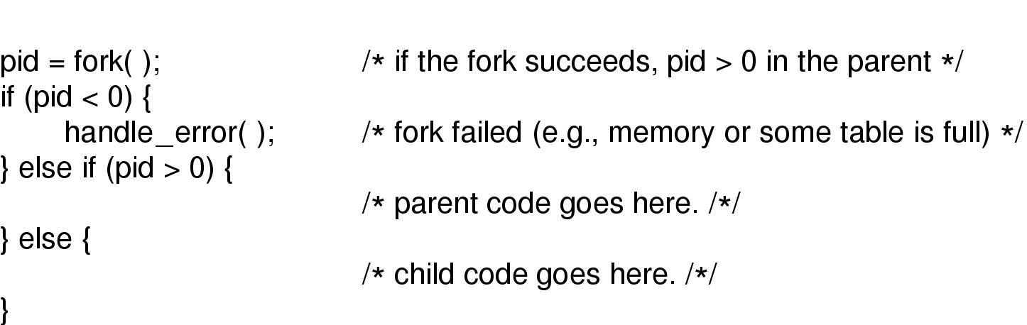
Process Creation in Linux
The fork system call creates an exact duplicate of the original process, the file descriptors, registers, and everything else are of the same in the parent and child processes; The PID is used to distinguish processes.
Use fork to create new process

Slide 43
Process Creation in Linux: Fork()
The calling process traps to the kernel and creates a task structure and few other accompanying data structures;
Linux then looks for an available PID, and updates the PID hash table entry to point to the new task structure;
Memory is allocated for the child’s data and stack segments, and exact copies of the parent’s segments are made;
The child process starts running.

Slide 44
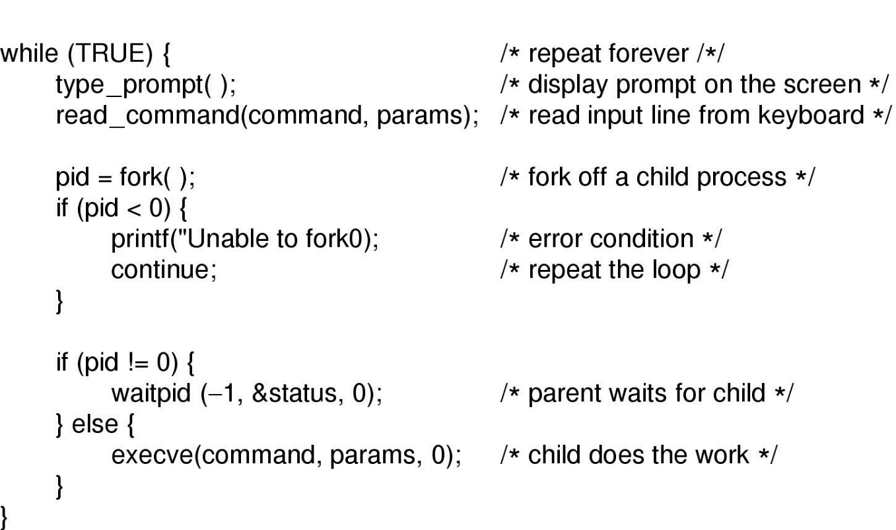
POSIX Shell
An implementation of shell based on the system calls fork, waitpid and exec
A simplified shell

Slide 45
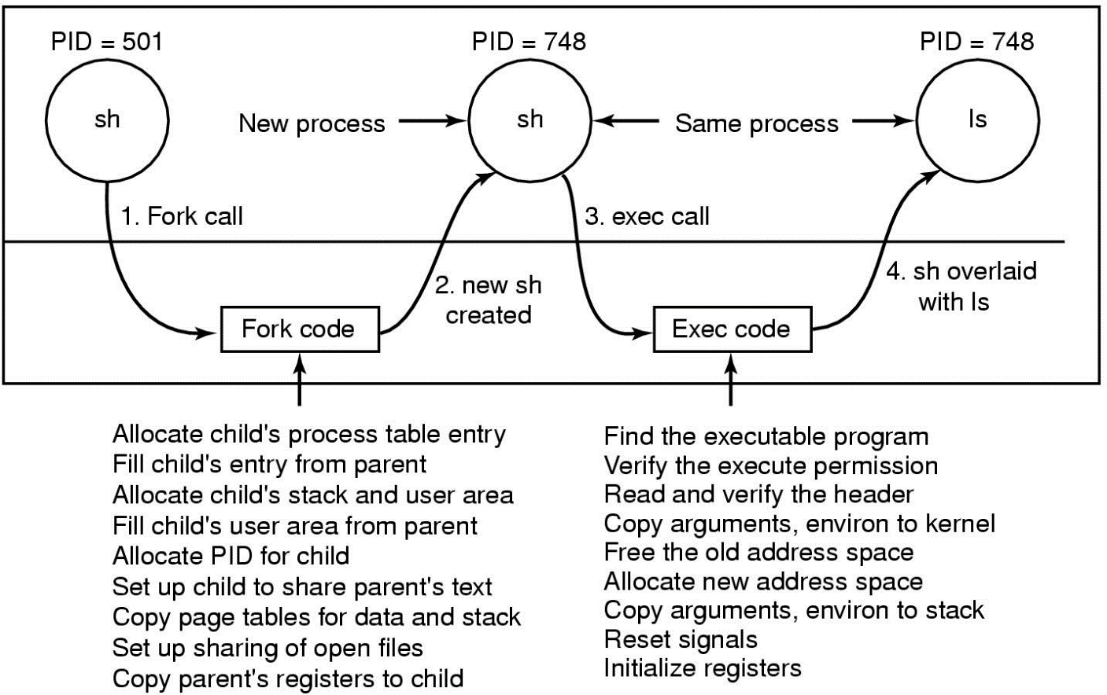
ls Commands
The shell creates a new process by forking off a clone of itself. The new shell then calls exec to overlay its memory with the contents of the executable file ls
The steps in executing the command ls typed to the shell

Slide 46
主观题
1分
What is thread？What are the difference between thread and process?
正常使用主观题需2.0以上版本雨课堂
作答

Slide 47
Thread
Question: What is thread? What are the differences between processes and threads?
Threads are parts of processes;
Threads are the smallest units that CPU schedules;
A process contains one thread or multiple threads;
Threads in the process share resources and data
The cost of thread creation/switching is lower

Slide 48
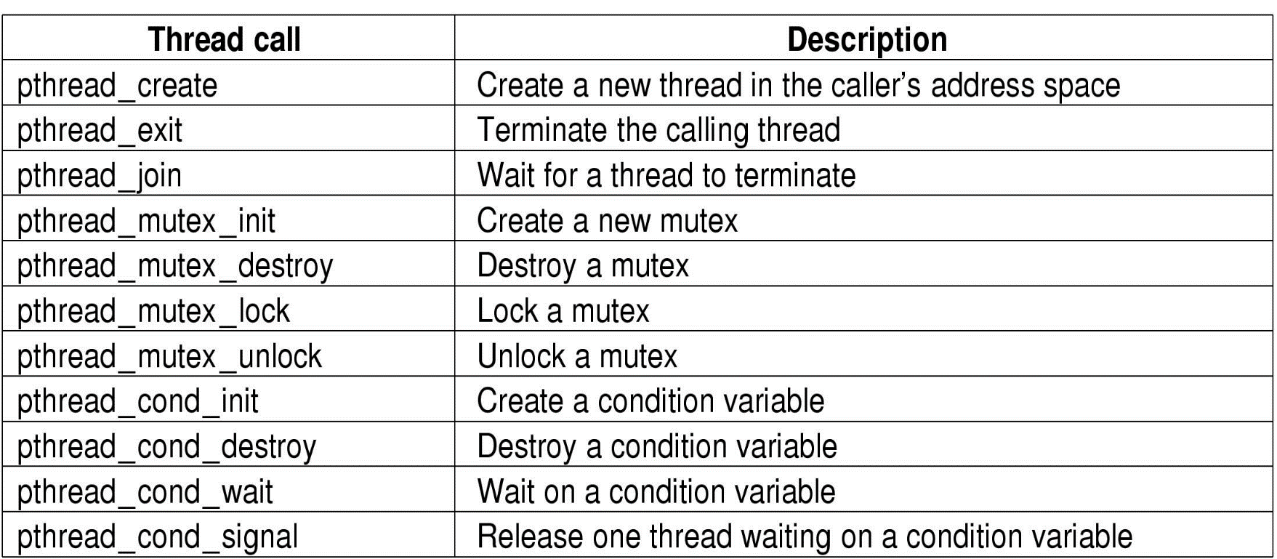
POSIX Threads
Calling interfaces of POSIX threads

Slide 49
Linux Thread Creation
#include<stdio.h>
#include<pthread.h>
#include<stdlib.h>
void *thfun(void *arg)
{
printf("new thread! %s\n", (char*)arg);
return ((void *)0);
}
int main(int argc ,char *argv[])
{ pthread_t pthid;
int ret=pthread_create(&pthid,NULL,thfun, (void *)"hello");
if(ret!=0){
perror("create thread failed");
exit(EXIT_FAILURE);
}
printf("main thread!\n");
sleep(1);
return 0;
}

Slide 50
Thread Scheduling
Linux threads are kernel threads, so scheduling is based on threads, not processes.
The common process/thread scheduling algorithms:
First come first served
Shortest job first
Round Robin Scheduling
Priority Scheduling
…

Slide 51
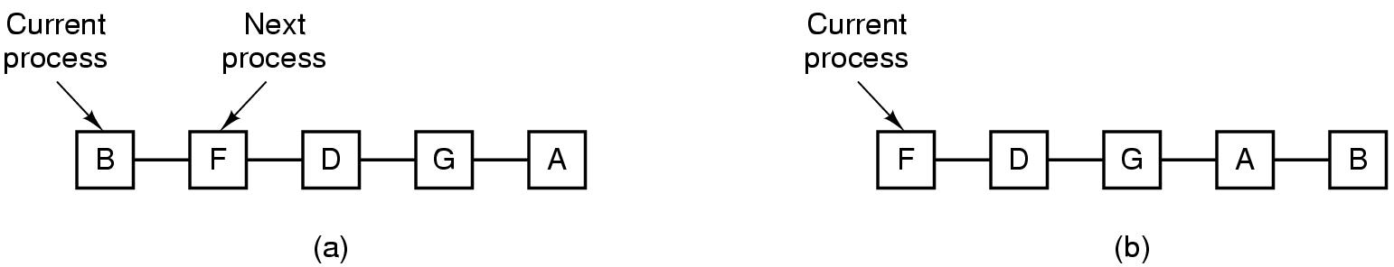
Round Robin (RR) Scheduling
Each process gets a small unit of CPU time (time quantum). After this time has elapsed, the process is preempted and added to the end of the ready queue.
If there are n processes in the ready queue and the time quantum is q, then each process gets 1/n of the CPU time. No process waits more than (n-1)q time units.
Performance
q large ⇒ FIFO
q small ⇒ q must be large with respect to context switch, otherwise overhead is too high.
51

Slide 52
Example of RR with Time Quantum = 20
Process Burst Time
P₁ 53
P₂ 17
P₃ 68
P₄ 24
The Gantt chart is:
Typically, higher average turnaround than SJF, but better response.
P₁
P₂
P₃
P₄
P₁
P₃
P₄
P₁
P₃
P₃
0
20
37
57
77
97
117
121
134
154
162
52

Slide 53
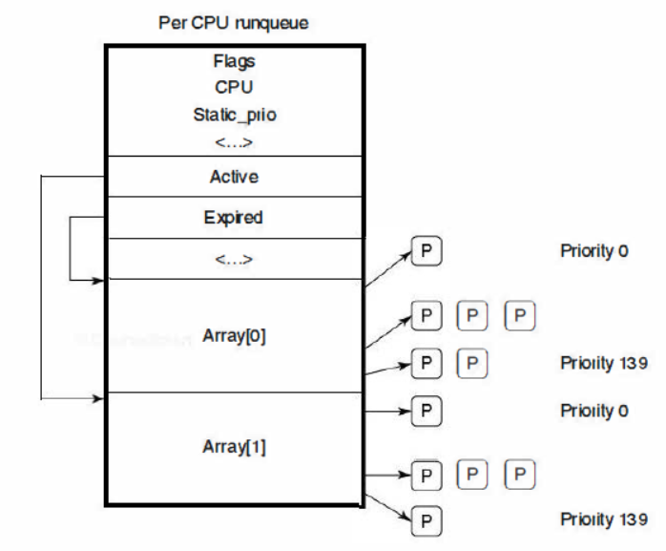
Scheduling in Linux: O(1) Scheduler
Two kinds of queues: Active, Expired
O(1) time complexity: select a task from the active queue with the highest priority. If the task’s time quantum expires, it is moved to the expired list.
Higher priority task has larger time quantum.

Slide 54
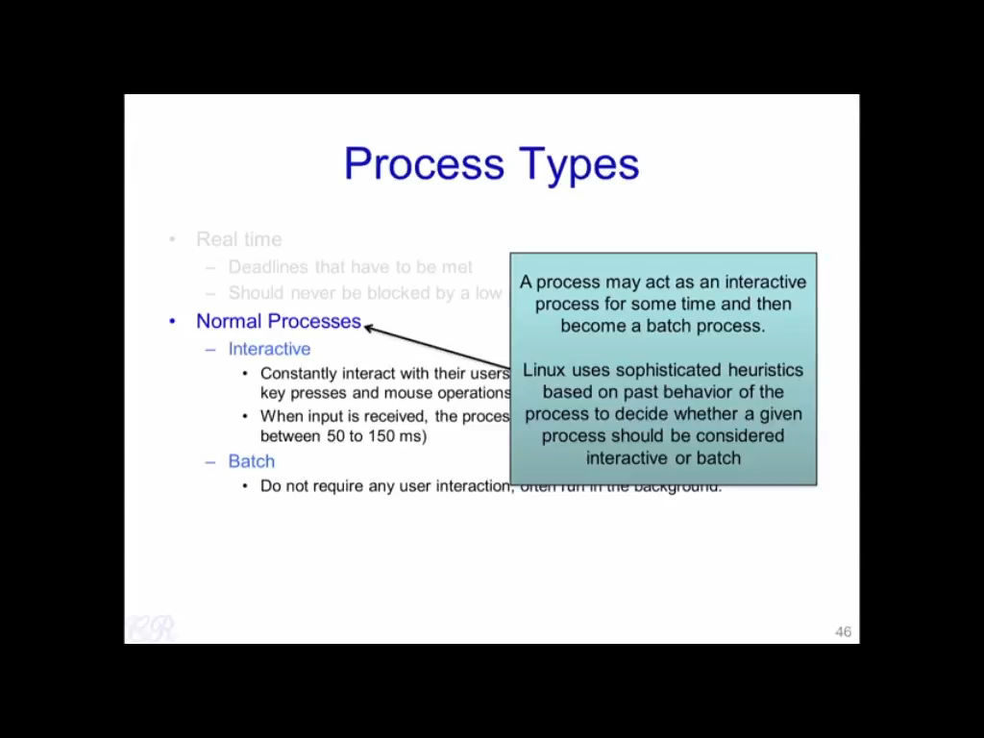

Slide 55
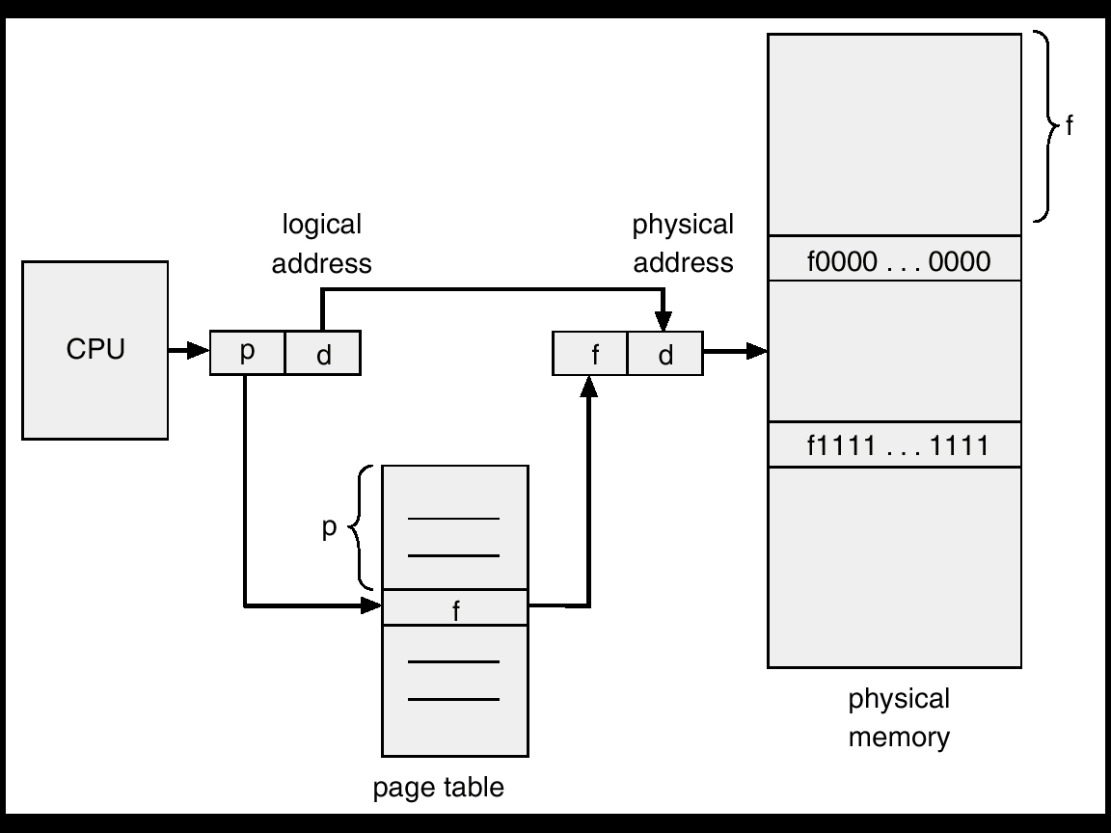
Memory Management in Linux
Virtual Memory (VM):
Allow multiple processes share the physical memory;
Allow the execution of big process.
Techniques to improve VM’s efficiency:
TLB, multi-level page table

Slide 56
主观题
1分
Please explain how TLB and multi-level page table improve the performance of virtual memory？
正常使用主观题需2.0以上版本雨课堂
作答

Slide 57
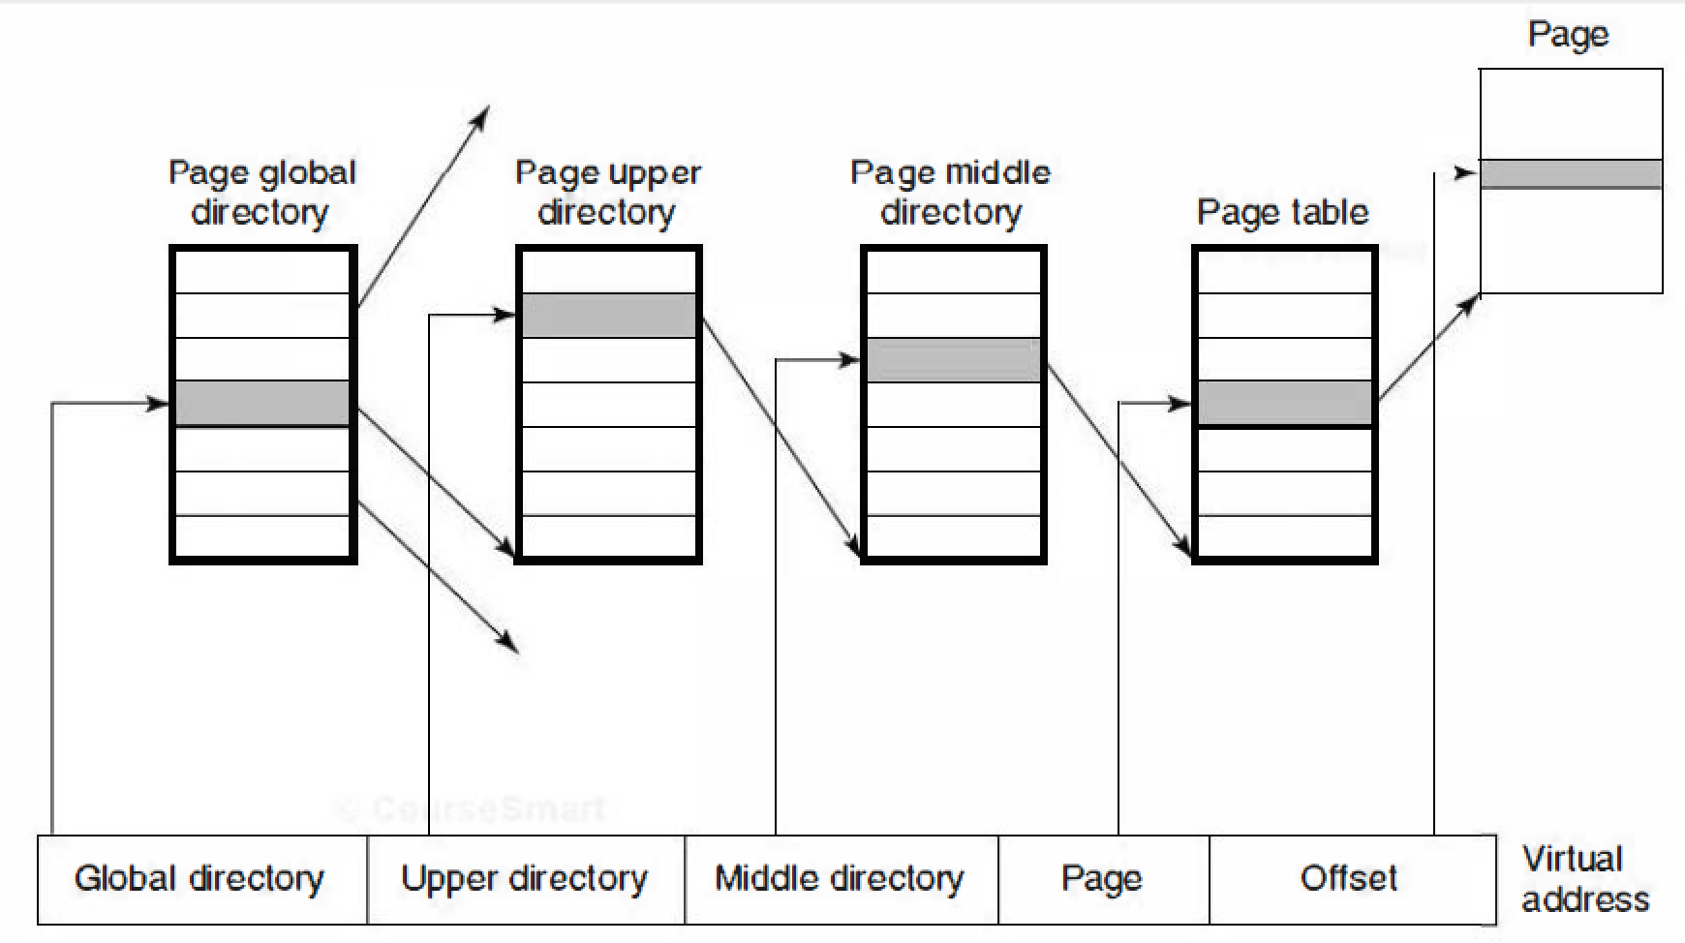
Multiple Level Page Table
Each virtual address is broken up into five fields. The value of each directory entry is a pointer to one of the next-level directories.
Linux uses four-level page tables

Slide 58
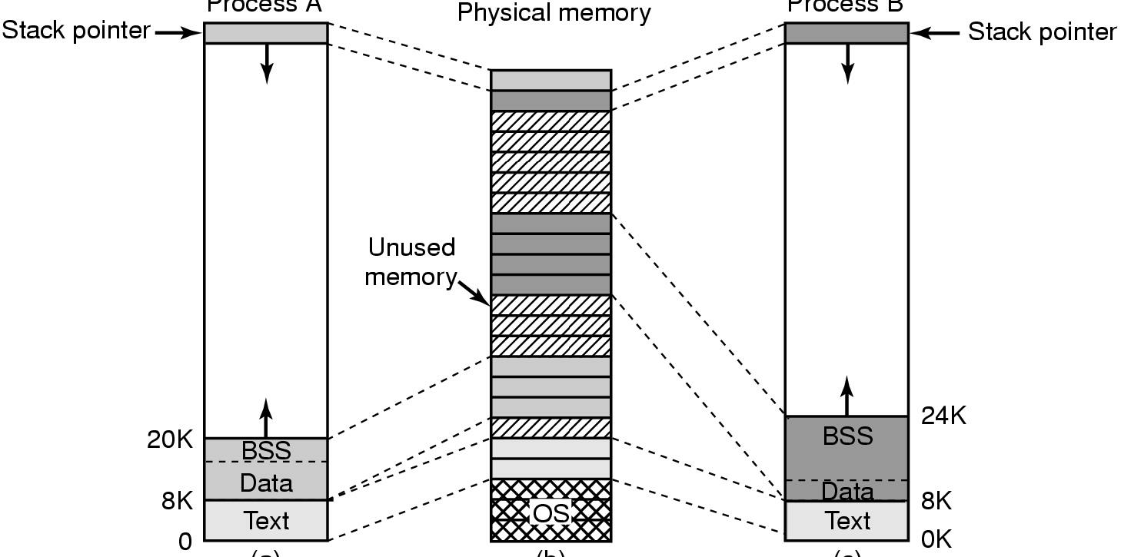
Memory Management in Linux
Memory management in Linux is based on paging; Processes can share Text Segment.
Process A
Process B
A shares same code fragment with B, but not data and stack.

Slide 59
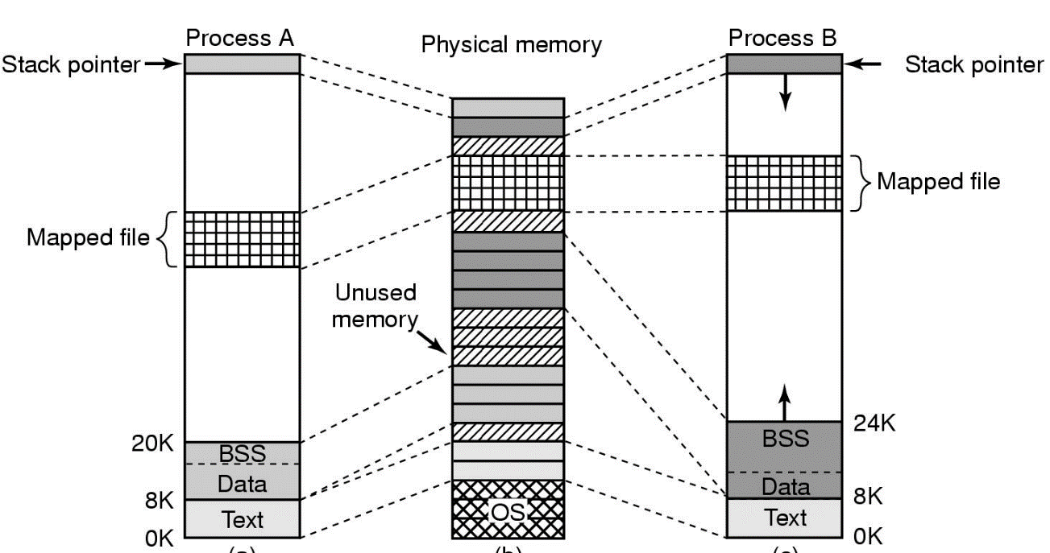
Memory-mapped Files
Processes in Linux can access file data through memory-mapped files so that they can map the same file simultaneously.
System calls for memory-mapped files：
void * mmap( void *start, size_t length, int prot , int flags,int fd, off_t offset);

Slide 60
Memory-mapped Files
void * mmap(
void *start, size_t length,
int prot , int flags,
int fd, off_t offset );
Start：mapped to the starting address of the process space，usually → null
Length： the number of bytes mapped to the calling process address space
prot : Access mode， PROT_READ , PROT_WRITE, PROT_EXEC, PROT_NONE
Flags：MAP_SHARED , MAP_PRIVATE , MAP_FIXED。
Offset: usually → 0，start from the beginning
Fd: get by open()。
The return value of the function is the address of the file mapped to the process space, and the process can operate directly. The starting address is the effective address of the value.

Slide 61
Memory-mapped Files
#include <sys/mman.h>
fd = open (name, flag, mode);
if(fd<0){ printf("error!\n");}
ptr = mmap(NULL, len , PROT_READ|PROT_WRITE|PROT_EXEC, MAP_SHARED , fd , 0);
The user process can read the file just like reading memory, which is more efficient than using the read / write system call.

Slide 62
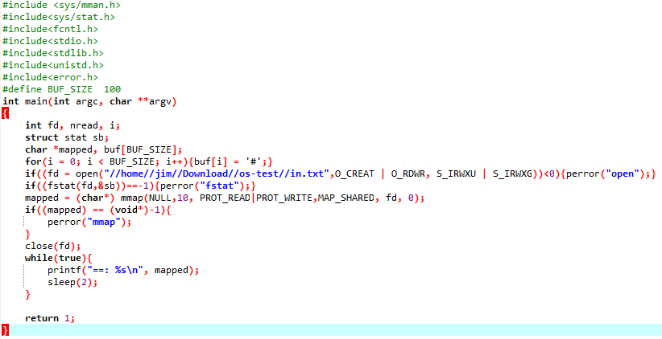
Inter Process Communication via Memory-map file

Slide 63
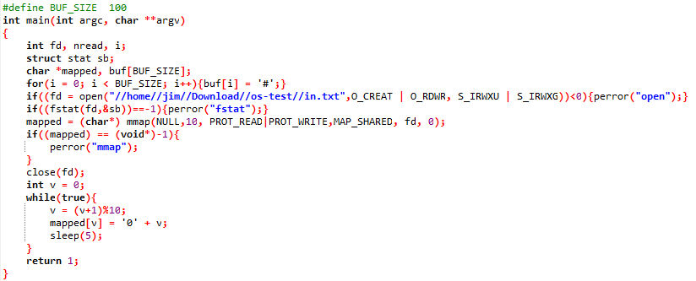
Inter Process Communication via Memory-map file

